Slide 1
Probability
When connecting his Nintendo Wii to the TV, Jimmy
needs to attach a yellow wire, a red wire and a white
wire to the correct inputs on the TV. If Jimmy closes
his eyes and randomly inserts the 3 wires into the 3
inputs, what is the probability he will correctly hook
up all 3 wires? Express your answer as a common
Fraction.

Slide 2
Probability
When connecting his Nintendo Wii to the TV, Jimmy
needs to attach a yellow wire, a red wire and a white
wire to the correct inputs on the TV. If Jimmy closes
his eyes and randomly inserts the 3 wires into the 3
inputs, what is the probability he will correctly hook
up all 3 wires? Express your answer as a common
Fraction.
In total, 6 ways: YRW, YWR, RYW, RWY, WYR, WRY.
Only one of those is correct, so the probability is 1/6.

Slide 3
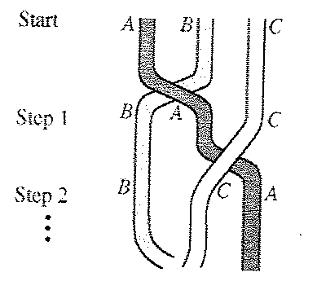
Sequence
In the figure shown, three wires are braided. That is, by starting
in the order A, B, C, the outer left wire A is brought over wire B to
the middle position, forming the order shown in step 1, then the
outer right wire C is brought to the new middle position shown in
step 2, and so on, alternatively bringing each new left and each
new right wire to the middle. At what numbered step does the
braid first repeat the original order A, B , C?

Slide 4
Sequence
In the figure shown, three wires are braided. That is, by starting
in the order A, B, C, the outer left wire A is brought over wire B to
the middle position, forming the order shown in step 1, then the
outer right wire C is brought to the new middle position shown in
step 2, and so on, alternatively bringing each new left and each
new right wire to the middle. At what numbered step does the
braid first repeat the original order A, B , C?
Start ABC
Step 1 BAC
Step 2 BCA
Step 3 CBA
Step 4 CAB
Step 5 ACB
Step 6 ABC

Slide 5
Circle
A giant, circular clock is painted on the pavement in the
parking lot of MC Middle School. The clock has a radius
of 18 feet. If Jack walks clockwise around the edge of the
clock from the 2 to the 9, how many feet has she walked.
Express your answer in terms of π.

Slide 6
Circle
A giant, circular clock is painted on the pavement in the
parking lot of MC Middle School. The clock has a radius
of 18 feet. If Jack walks clockwise around the edge of the
clock from the 2 to the 9, how many feet has she walked.
Express your answer in terms of π.
7/12•2π•18 = 21π (feet)

Slide 7
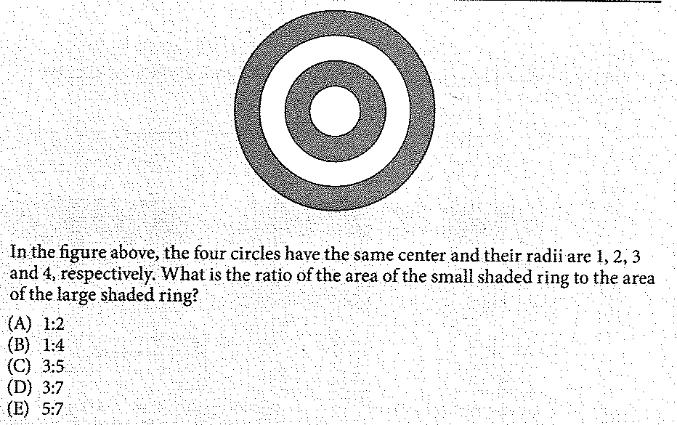
Area

Slide 8
Area
Answer: D

Slide 9
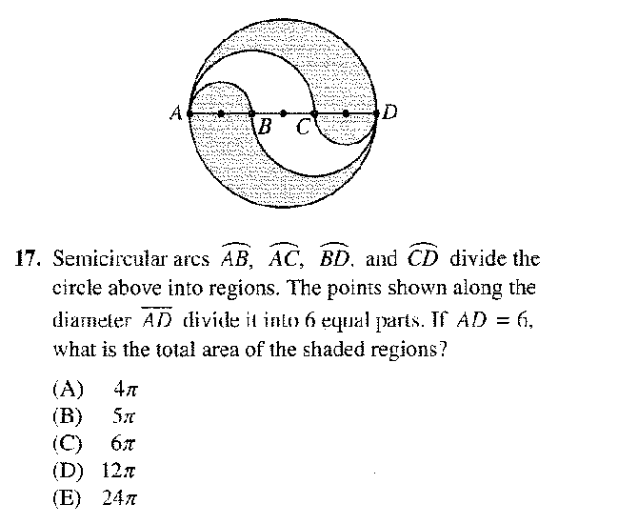
Area

Slide 10
Area
small circle: π
Large circle: 9π - 4π = 5π
Together 6π
Answer: (C)

Slide 11
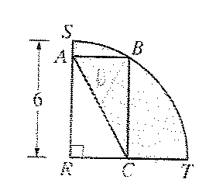
Circle
In the figure shown, arc SBT is one quarter of a circle
with center R and radius 6. If the length plus the
width of rectangle ABCR is 8, then the perimeter of
the shaded region is
8 + 3π
10 + 3π
14 + 3π
1 + 6π
12 + 6π

Slide 12
Circle
In the figure shown, arc SBT is one quarter of a circle
with center R and radius 6. If the length plus the
width of rectangle ABCR is 8, then the perimeter of
the shaded region is
8 + 3π
10 + 3π
14 + 3π
1 + 6π
12 + 6π
ST = 12π/4 = 3π
AC = RB = r = 6
TC + CR + AR + SA = 2r = 12
AR + CR = 8, TC + SA = 4
Total perimeter: 6 + 4 + 3π = 10 + 3π

Slide 13
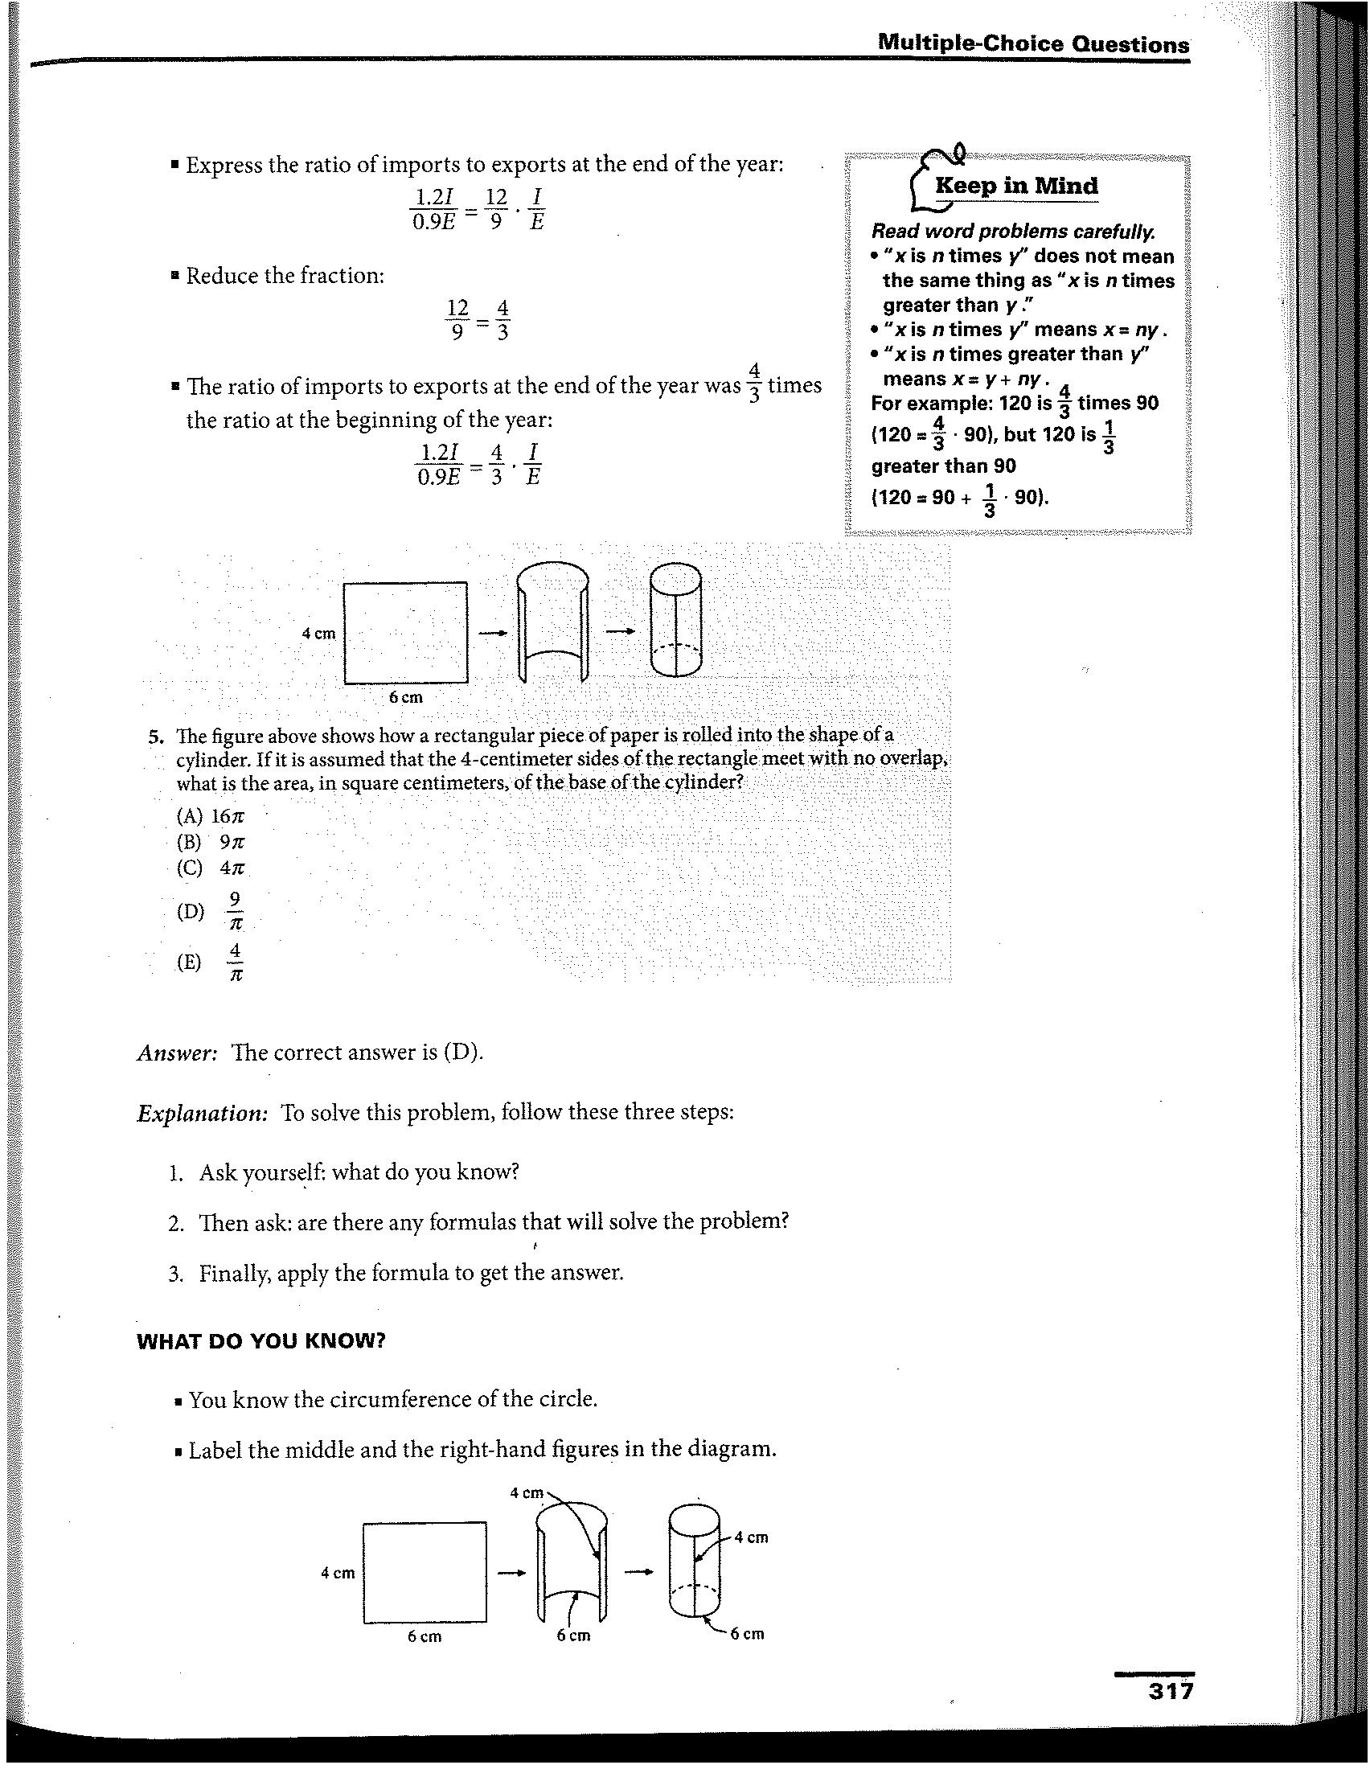
Circle

Slide 14
Circle
2πr = 6
r = 3/π
Area = πr² = 9/π

Slide 15
Rate
Rate of work: part of a task which is completed in one unit of time
Example: a painter can paint a room in 4 h
Rate of work: ¼ (1/4 of the room each hour)
Part of task completed = rate of work x time worked
Example: a faucet can fill a sink in 6 min, then in 5 min the faucet will fill 1/6 x 5 = 5/6 of the sink
Rate of work: 1/6 (1/6 sink each min)
Time worked: 5 min
Part of task completed: 1/5 x 5 = 5/6 (sink)

Slide 16
Rate
A painter can paint a wall in 20 min. The painter’s apprentice can paint the same wall in 30 min. How long will it take to paint the wall when they work together?

Slide 17
Rate
A painter can paint a wall in 20 min. The painter’s apprentice can paint the same wall in 30 min. How long will it take to paint the wall when they work together?
Unknown time to paint the wall working together: t
Rate of work x time worked = part of task completed
Painter 1/20 x t = t/20
Apprentice 1/30 x t = t/30
t/20 + t/30 = 1
3t + 2t = 60
5t = 60
T = 12 (min)
Working together, they will paint the wall in 12 min.

Slide 18
Rate
A small water pipe takes three times longer to fill a tank than does a large water pipe. With both pipes it takes 4 h to fill the tank. Fine the time it would take the small pipe working alone to fill the tank.

Slide 19
Rate
A small water pipe takes three times longer to fill a tank than does a large water pipe. With both pipes it takes 4 h to fill the tank. Fine the time it would take the small pipe working alone to fill the tank.
Time to fill the tank (large pipe): t
Time to fill the tank (small pipe): 3t
Rate Time Part
Small pipe 1/3t 4 4/3t
Large pipe 1/t 4 4/t
4/3t + 4/t = 1
4 + 12 = 3t
16 = 3t
The small pipe working alone takes 16 h to fill the tank.

Slide 20
Rate
Two computer printers that work at the same rate are working together to print the payroll checks for a large corporation. After working together for 2 h, one of the printers quits. The second requires 3 more hours to complete the checks. Find the time it would take one printer working alone to print the checks.

Slide 21
Rate
Two computer printers that work at the same rate are working together to print the payroll checks for a large corporation. After working together for 2 h, one of the printers quits. The second requires 3 more hours to complete the checks. Find the time it would take one printer working alone to print the checks.
Time for one printer to complete the job: t
Rate time part
1st printer 1/t 2 2/t
2nd printer 1/t 5 5/t
2/t + 5/t = 1
2 + 5 = t
T = 7
Working alone, one printer takes 7 h to print the checks.

Slide 22
Uniform Motion Problems (7th)
The speed of a boat in still water is 20 mph. The boat
traveled 75 mi down a river in the same amount of time
as it traveled 45 mi up the river. Find the rate of the
river’s current.
The unknown rate of the river’s current: r
Distance / Rate = Time
Down river 75 / (20 + r) = 75/(20 + r)
Up river 45 / (20 – r) = 45/(20 – r)
75/(20 + r) = 45/(20 – r)
75(20 – r) = 45(20 + r)
5(20 – r) = 3 (20 + r)
100 – 5r = 60 + 3r
40 = 8r, r = 5
The rate of the river’s current is 5 mph.

Slide 23
Uniform Motion Problems (7th)
A cyclist rode the first 20 mi of a trip at a constant rate.
For the next 16 mi, the cyclist reduced the speed by 2
mph. The total time for the 36 mi was 4 h. Find the rate
of the cyclist for each leg of the trip.

Slide 24
Uniform Motion Problems
The total time for a sailboat to sail back and forth across a
lake 6 km wide was 2 h. The rate sailing back was 3 time
the rate sailing across. Fine the rate across the lake.

Slide 25
Uniform Motion Problems
The total time for a sailboat to sail back and forth across a
lake 6 km wide was 2 h. The rate sailing back was 3 time
the rate sailing across. Fine the rate across the lake.
Rate sailing across the lake: r
Rate sailing back: 3r
Distance Rate Time
across 6 r 6/r
Back 6 3r 6/3r
The total time for the trip was 2 h.
6/r + 6/3r = 2; 3/r + 3/3r = 1
9 + 3 = 3r; 12 = 3r; r = 4
The rate across the lake was 4 km/h.

